Slide 1
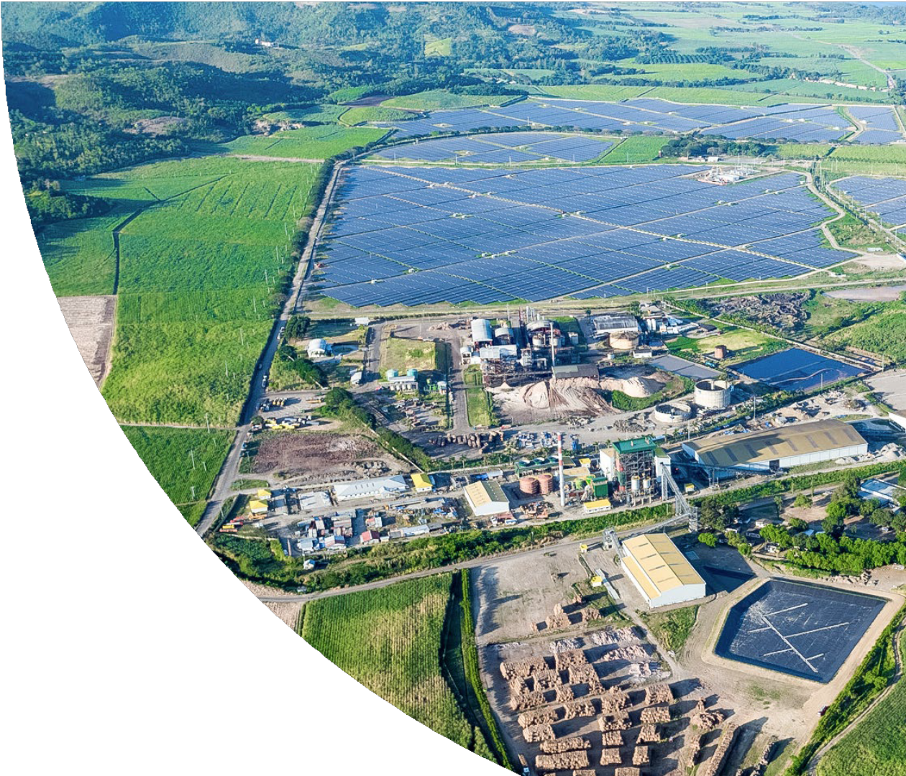
Capitalising on the energy transition´s
growth potential.
ThomasLloyd Climate Solutions N.V.¹
Key statements: Connect, facilitate, enable, …….
first, at scale Decarbonisation-as- a-Service (DaaS) major for corporates and municipalities.
We create sustainable ecosystems
We are…. The first ….. Eye catcher
Capitalisierung on energy trans growth potential
B Corp, Impact, ….
March 2025

Slide 2
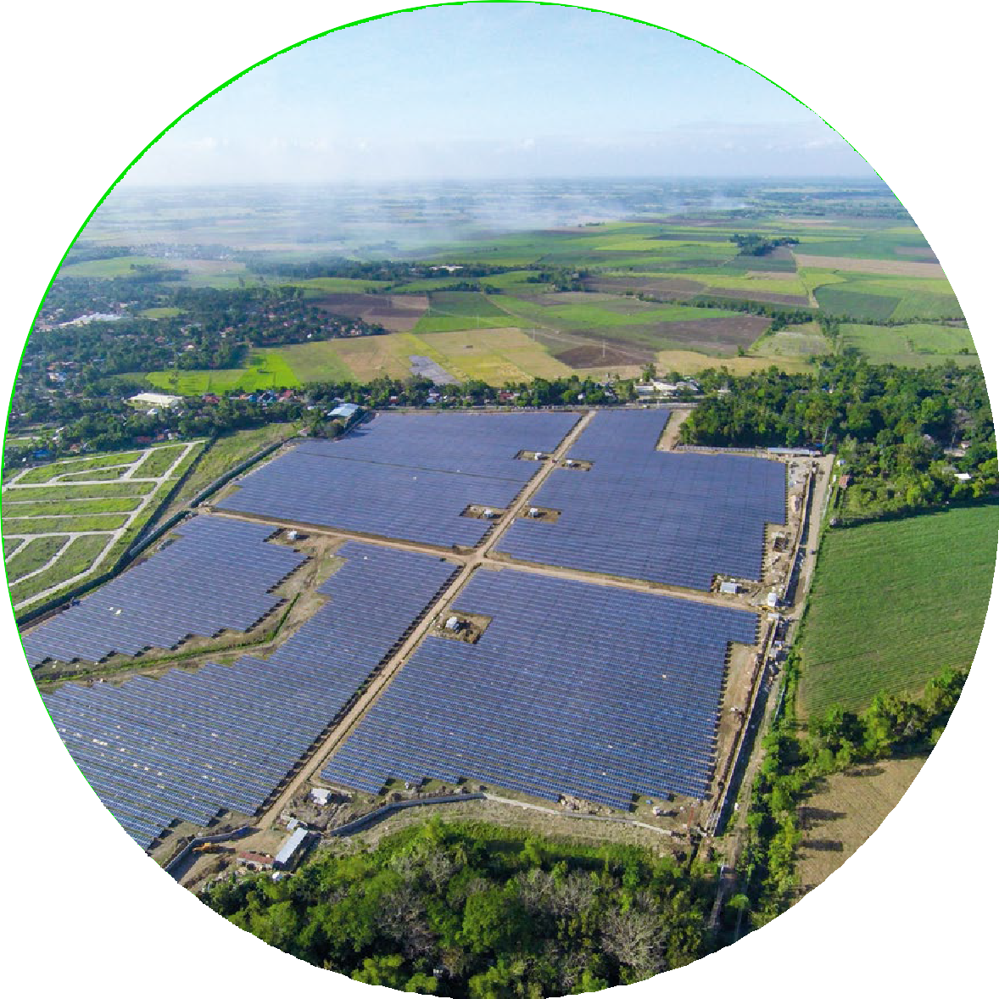
Content.
Who we are – at a glance................................................................ 3
Leadership.......................................................................................... 4
The global journey to net-zero. A historic investment opportunity ........................................................................................ 5
Our pure-play approach to capitalise on the transition’s growth potential ............................................................................... 6
Business segment: Climate Infrastructure ................................. 7
Business segment: Sustainable Fuels ........................................ 10
Business segment: Climate Finance........................................... 13 Selected customers, partners and stakeholders ................... 16 Our strategy to deliver scalable, profitable and
sustainable growth......................................................................... 17
An immediate diversified pipeline to drive accelerated growth ............................................................................................... 18
Appendix .......................................................................................... 20
Important notices ...........................................................................22

Slide 6
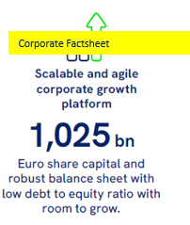
Company at a glance.
An impact-focussed …. Pure play
- Name TCS
- ISIN; Tcker
ABN Amro
Freefloat %
Sustainability
- Structure
- Sector
- Peergroup
- Capitlisation
- Website www.thomas-lloyd.com
Notes:
Collectively, we have worked with a vast array of key market participants in the region, our network is the equal of any in the sector

Slide 9
distributed energy, on-site generation
RE
3 Biopowers existing: PIM Capex initiatives, increase gross capacity add/larger boiler, embedded BESS… PH
2-3 gf developments: India, Thailand, …..
Convert coal into biomass: Indonesia, Vietnam, ……
MSW ….
RTC ….. India
[Non-grid solutiions/ Virtual powerstations, aggregation ….] > interact with principals
Fuel
- …
M&A
Principals C&I Customer, Municipalities, Private clients / off market transaction / direct BD and origination (better than public RFPs and tenders)

Slide 10
Own the platform

Slide 12
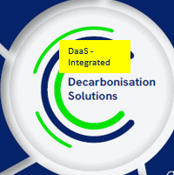
…
Who we (are) / work with and for
Selected customers, partners and stakeholders.
Our ecosystem
The platform connects
The Investors in GEEREF include:
European Union
Germany
Norway
The Investors in CIIF include:
Japan Bank for International Cooperation
Sumitomo Mitsui Banking Cooperation
Brookfield Asset Management
s
n
o
i
t
u
t
i
t
(
s
C
n
o
I
c
-
i
)
l
I
5,000+
Small and medium- sized farmers
b
n
u
v
P
e
&
s
t
s
s
o
r
r
e
e
s
t
&
a
m
r
o
P
o
t
a
p
s
r
r
u
t
o
C
n
C
e
FE CLEAN ENERGY GROUP
r
D
s
&
R
C
e
o
c
r
n
p
a
o
n
r
i
a
F
t
e
r
t
&
c
e
P
j
o
20,000+
Private, wholesale and institutional clients²
The Investors in Managed Co-Lending Portfolio Program (MCPP) include:
Peoples’s Bank of China
Allianz Global Investors
Eastspring Investments
AXA
Hong Kong Monetary Authority
Liberty Specialty Markets
Munich Re
Swiss Re
¹ All companies mentioned on this page are/have been counterparty to one or more transactions with projects, assets or businesses directly or indirectly owned, managed or advised by the Group or any of its affiliates.
² Invested through Climate Finance Impact Investment Solutions structured, managed or advised by CF.
16
Notes:
Collectively, we have worked with a vast array of key market participants in the region, our network is the equal of any in the sector

Slide 13
Our ecosystem
The platform connects
Resell, recycle, exit margin
Holding periods
Capital deployment philosophy
Trusted supplier margin add
When to flip?
Everything is available for sale at the right price and time.
Key point platform, don´t need to own the assets …. We connect as much as little ..
Blended return
Asset heavy/asset light
Our goal: we return more per Euro
our edge.
… aggregate small and mid-sized assets, to deliver scale
…. Turn-key solutions
Deploy BS to facilitate business, plug gaps, underwrite,… enabling investor , Active managed
sharp, agile, adaptle model … / TCS is more than the sum of its parts
Gleiche Folie danach, wo wir bestehendes Portoflio IST über SOLL darüber legen
Own as little as possible and as much as necessary to control process/assets and secure longterm service contracts, its about control, not ownership

Slide 14
Financial History.
Notes:
Collectively, we have worked with a vast array of key market participants in the region, our network is the equal of any in the sector

Slide 15
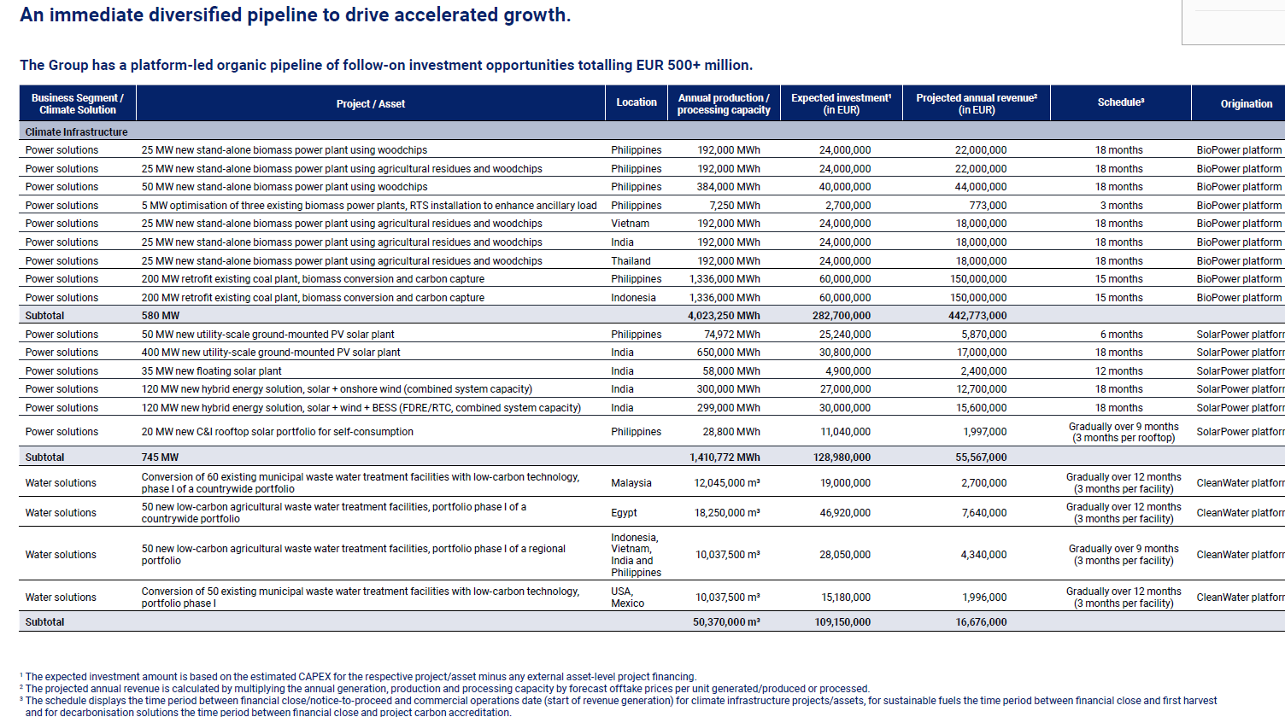
Where we see margins.
Growth Opps for businss / Business Plan Biom
Investment in value chain, integrated solutions > what brings what >
Different presentation of investment opps/pipeline
Infrastructure
Enhance/expand existing assets: RTS , ……
New Developments
Sust Fuel
Climate Finance
Core activities (lower ret) and margin enhancement (CAPEX > REV > EBITDA > Margin increase)
100m-500m
Sources and uses table
_________________
Organic growth
M&A opps identified (pool of x)
C&I Customer, Municipalities, Private clients / off market transaction / direct BD and origination (better than public RFPs and tenders)
17

Slide 16
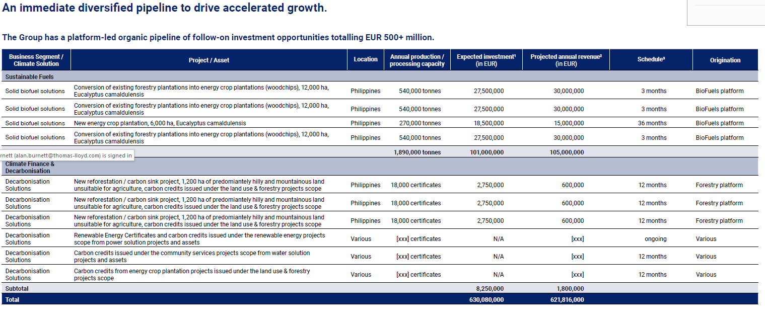
Not just adding more infra assets – more EPS growth pillars
With additions
Increase capacity at existing sites

Slide 17
Forecast. w/o and with funding
Notes:
Collectively, we have worked with a vast array of key market participants in the region, our network is the equal of any in the sector

Slide 18
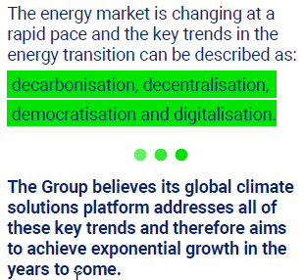
Why ThomasLloyd Climate Solutions.
European access to energy transition and technology in Asia, with significantly more impact and revenue than in developed markets.
With a focus on sustainably higher margin growth, particularly in the Asia-Pacific region
An entrepreneurial and innovative approach focussed on customers' needs leads to higher retention and higher margins.
Over 27.6 GW of execution experience and a proven ability to arbitrage global experience and local knowledge gives us an edge
The opportunities for holistic energy transition solutions worldwide remain vast, often fragmented and under-penetrated.
Across power generation, energy and carbon trading, energy efficiency and related technical and financial services
Today, the corporate strategy is set and the foundations required for global expansion in respect of governance structure and leadership team have been laid. As Climate change doesn´t happen 2050, but the next 10 years are decisive, it´s now all about speed and scale.
After 22 years as a private business, the company is expected to be listed on Euronext Amsterdam in Q4 2024 /the coming months and is seeking strategic growth partners.
The uneven distribution of capital creates significant variances in market development, competition and opportunities
Our sweet spot is focusing on overlooked areas and projects, where the competition is lower and yet the projects are many.
Our active pipeline of around $630m, covers over25 projects, across 5 proven technologies, and 9 countries
Where others seek scale alone, our goal is to deliver higher growth and positive environmental and societal impact.
Clean power, clean water, clean waste. A single platform.
Positioning /Approach / Overview [benefits to shareholders/ diversified income streams / A differentiated offering that capitalises on the energy transition growth, potential.) Build a decarbonization leader, Infra mayor … we have the people, the systems, market access > now capital….. To accelerate ….
Notes:
If you want to invest for high impact and your mandate is for European investment, TCS offers an unrivalled exposure to the highest impact economies. (Ex-China)
The corporate operating structure is to European standards, so the G in ESG meets the required levels.
TCS brings vast global experience to a nimble, European managed firm.
The opportunity is unrivalled. Unlike EU/NA clean energy, where demand significantly exceeds supply.
The pipeline is unique when compared to our competition. This is a great risk diversifier and can enhance earnings growth.
Where developed market opportunities are in a race to zero margins, we remain in a race to achieve a net-zero world, without compromising margins.

Slide 19
APPENDIX
Notes:
Collectively, we have worked with a vast array of key market participants in the region, our network is the equal of any in the sector

Slide 20
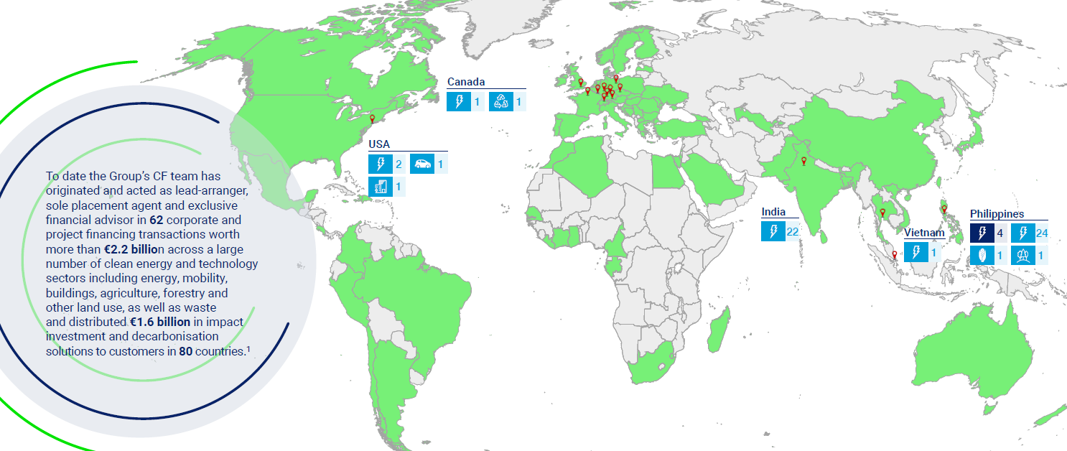
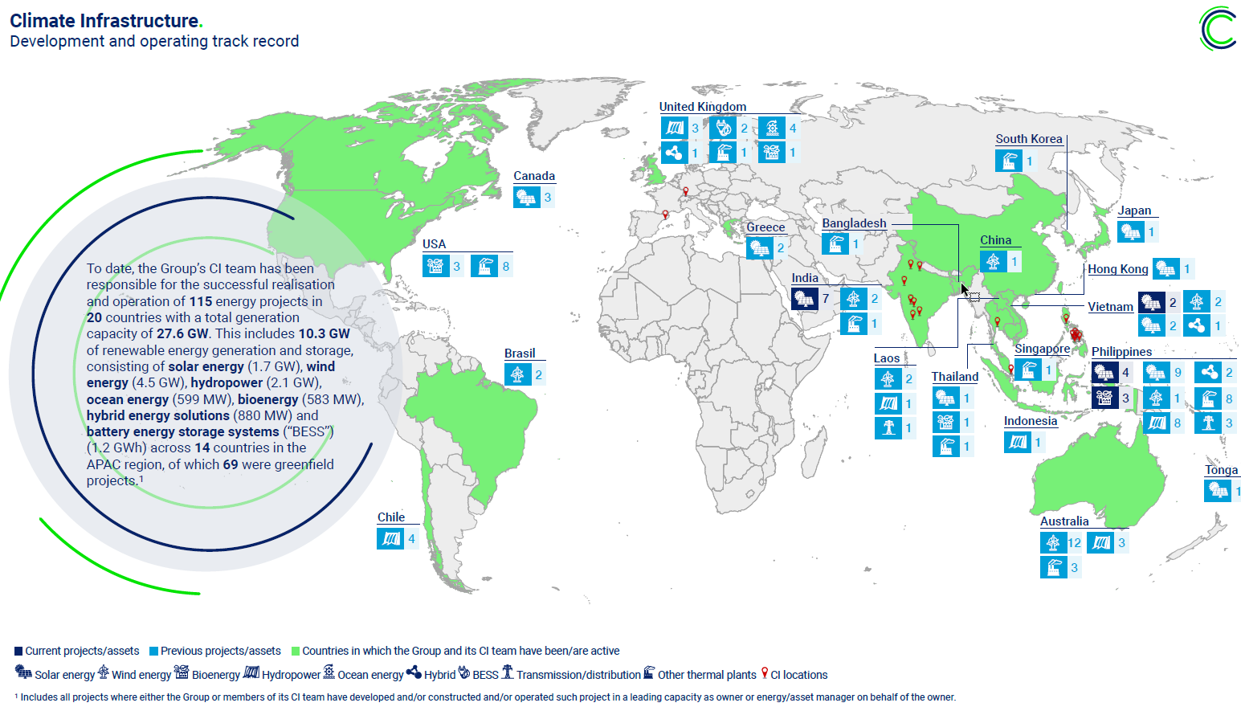
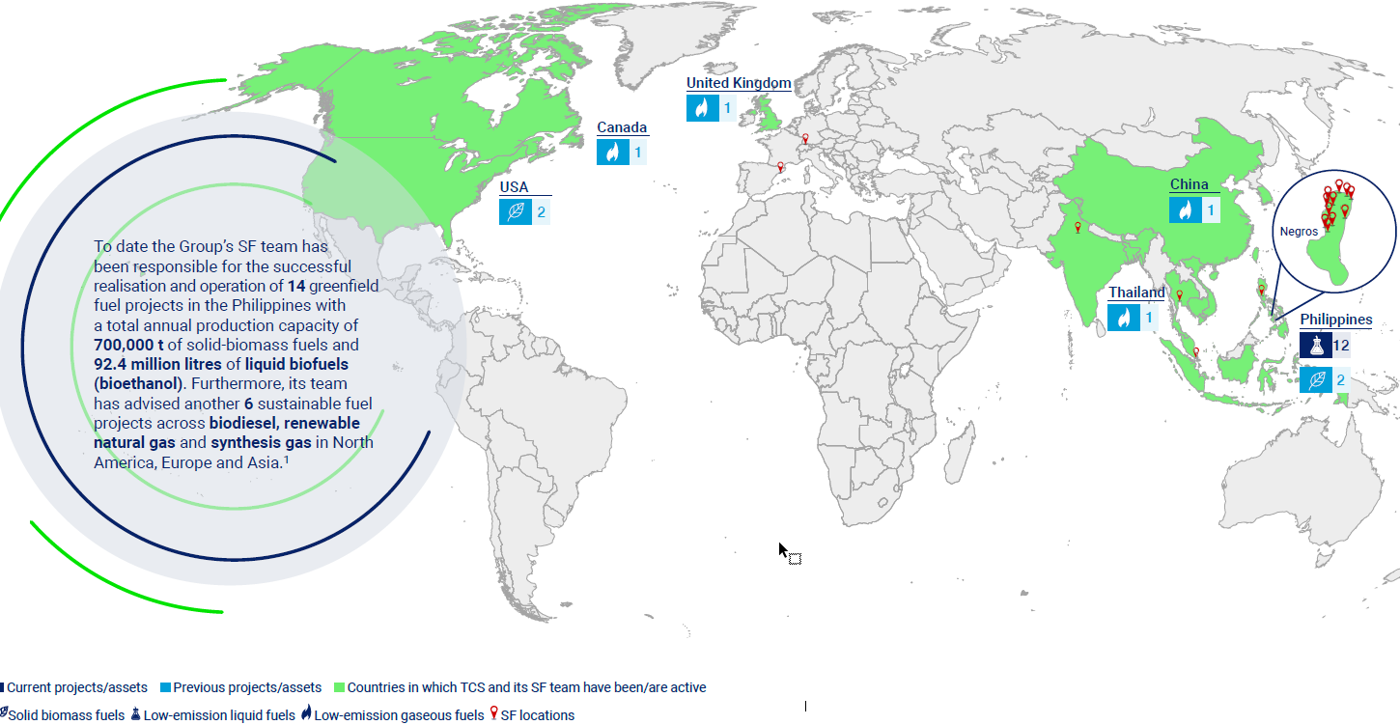
Development and operating track record.
…
Notes:
Collectively, we have worked with a vast array of key market participants in the region, our network is the equal of any in the sector

Slide 21
…
Selected customers, partners and stakeholders.
ESG / Impact
SFDR 9 Standard
Darstellung
Überschrift
What are we seling to whom?
The Investors in GEEREF include:
European Union
Germany
Norway
The Investors in CIIF include:
Japan Bank for International Cooperation
Sumitomo Mitsui Banking Cooperation
Brookfield Asset Management
s
n
o
i
t
u
t
i
t
(
s
C
n
o
I
c
-
i
)
l
I
5,000+
Small and medium- sized farmers
b
n
u
v
P
e
&
s
t
s
s
o
r
r
e
e
s
t
&
a
m
r
o
P
o
t
a
p
s
r
r
u
t
o
C
n
C
e
FE CLEAN ENERGY GROUP
r
D
s
&
R
C
e
o
c
r
n
p
a
o
n
r
i
a
F
t
e
r
t
&
c
e
P
j
o
20,000+
Private, wholesale and institutional clients²
The Investors in Managed Co-Lending Portfolio Program (MCPP) include:
Peoples’s Bank of China
Allianz Global Investors
Eastspring Investments
AXA
Hong Kong Monetary Authority
Liberty Specialty Markets
Munich Re
Swiss Re
¹ All companies mentioned on this page are/have been counterparty to one or more transactions with projects, assets or businesses directly or indirectly owned, managed or advised by the Group or any of its affiliates.
² Invested through Climate Finance Impact Investment Solutions structured, managed or advised by CF.
16
Notes:
Collectively, we have worked with a vast array of key market participants in the region, our network is the equal of any in the sector

Slide 22
Notes:
Collectively, we have worked with a vast array of key market participants in the region, our network is the equal of any in the sector

Slide 23
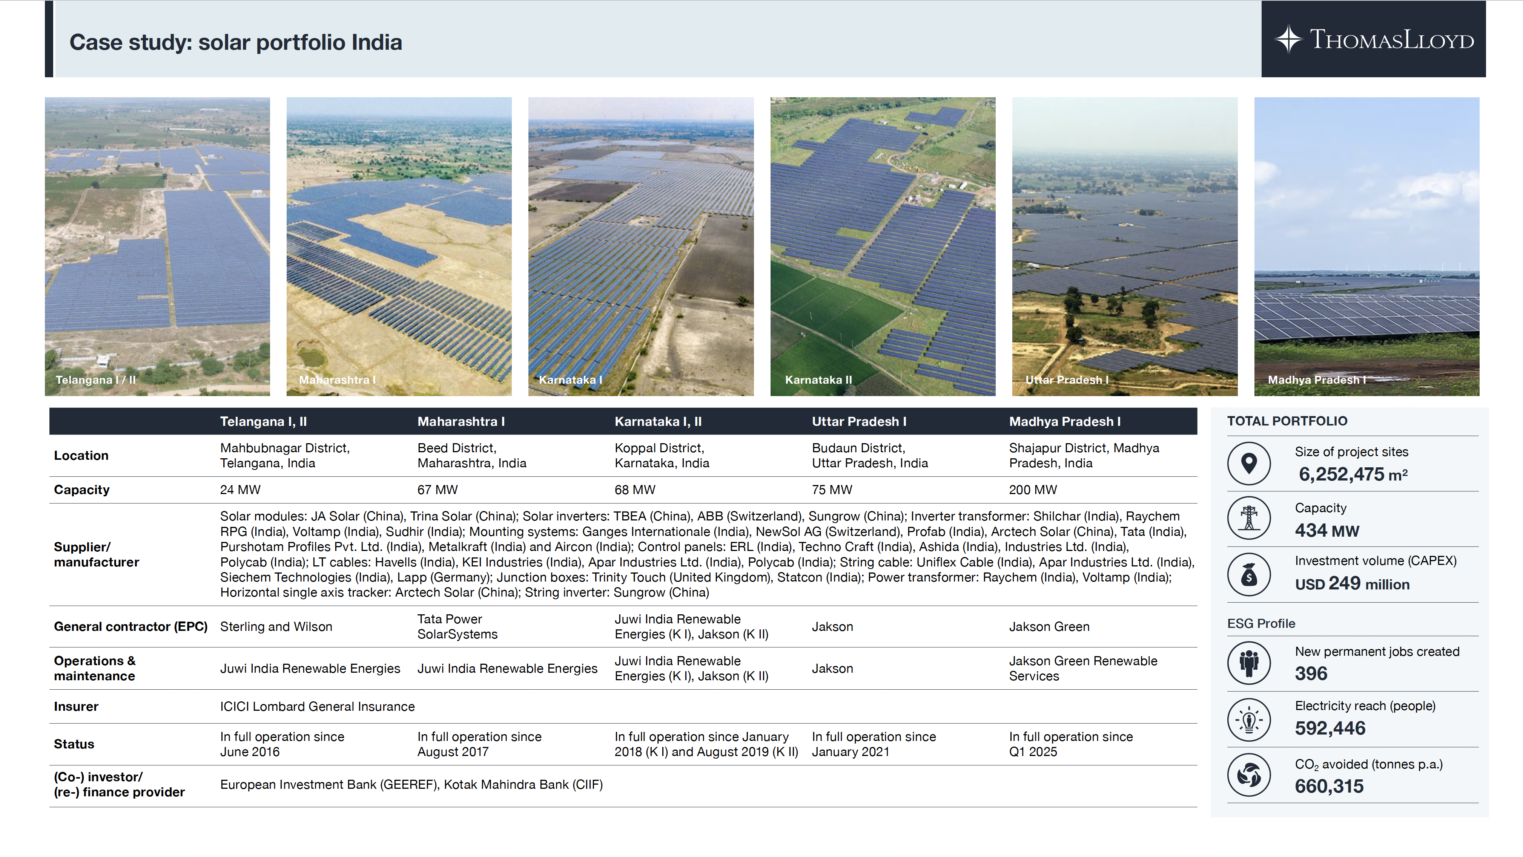
Projects Solar India
Notes:
Collectively, we have worked with a vast array of key market participants in the region, our network is the equal of any in the sector

Slide 24
Projects Biomass PH
Notes:
Collectively, we have worked with a vast array of key market participants in the region, our network is the equal of any in the sector

Slide 25
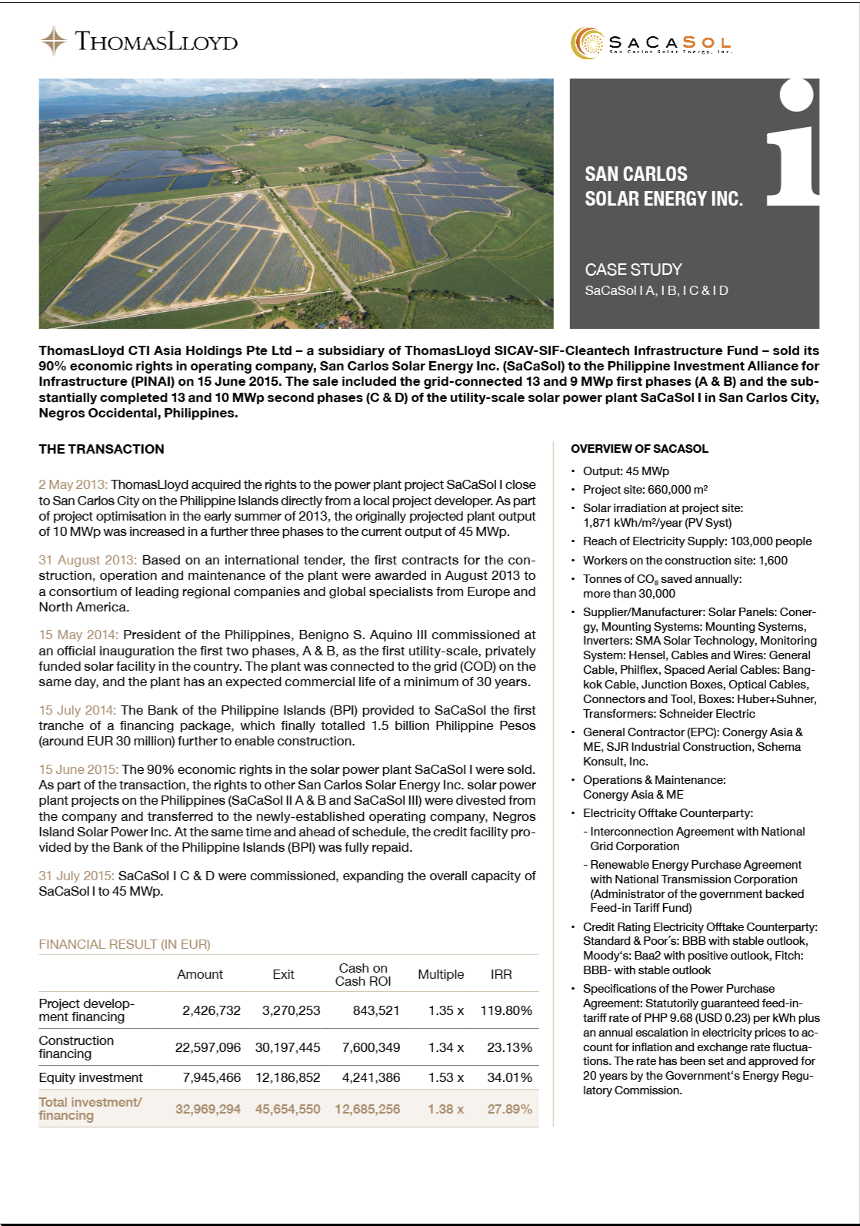
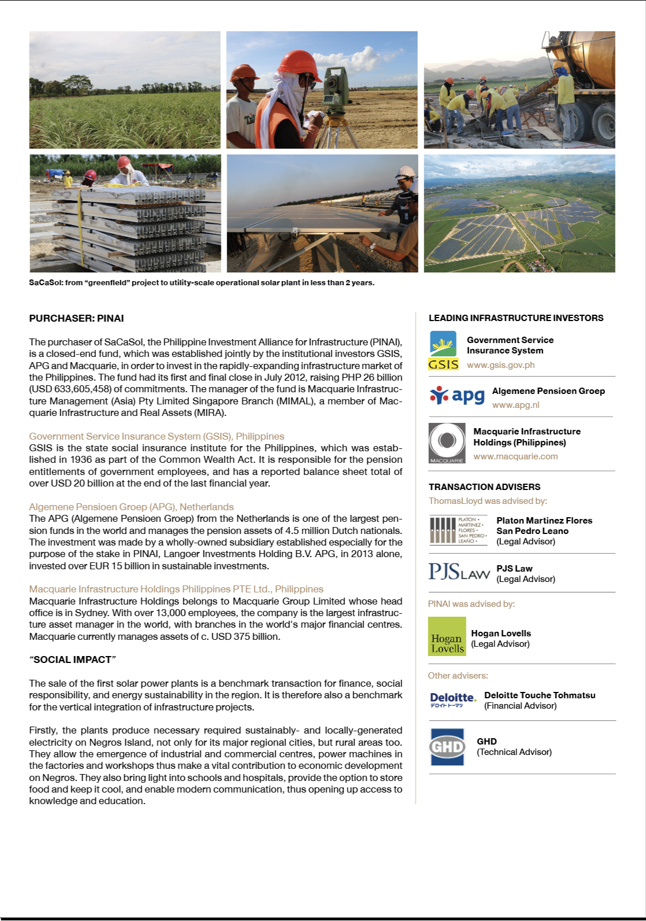
Case Study SacaSol
Notes:
Collectively, we have worked with a vast array of key market participants in the region, our network is the equal of any in the sector

Slide 26
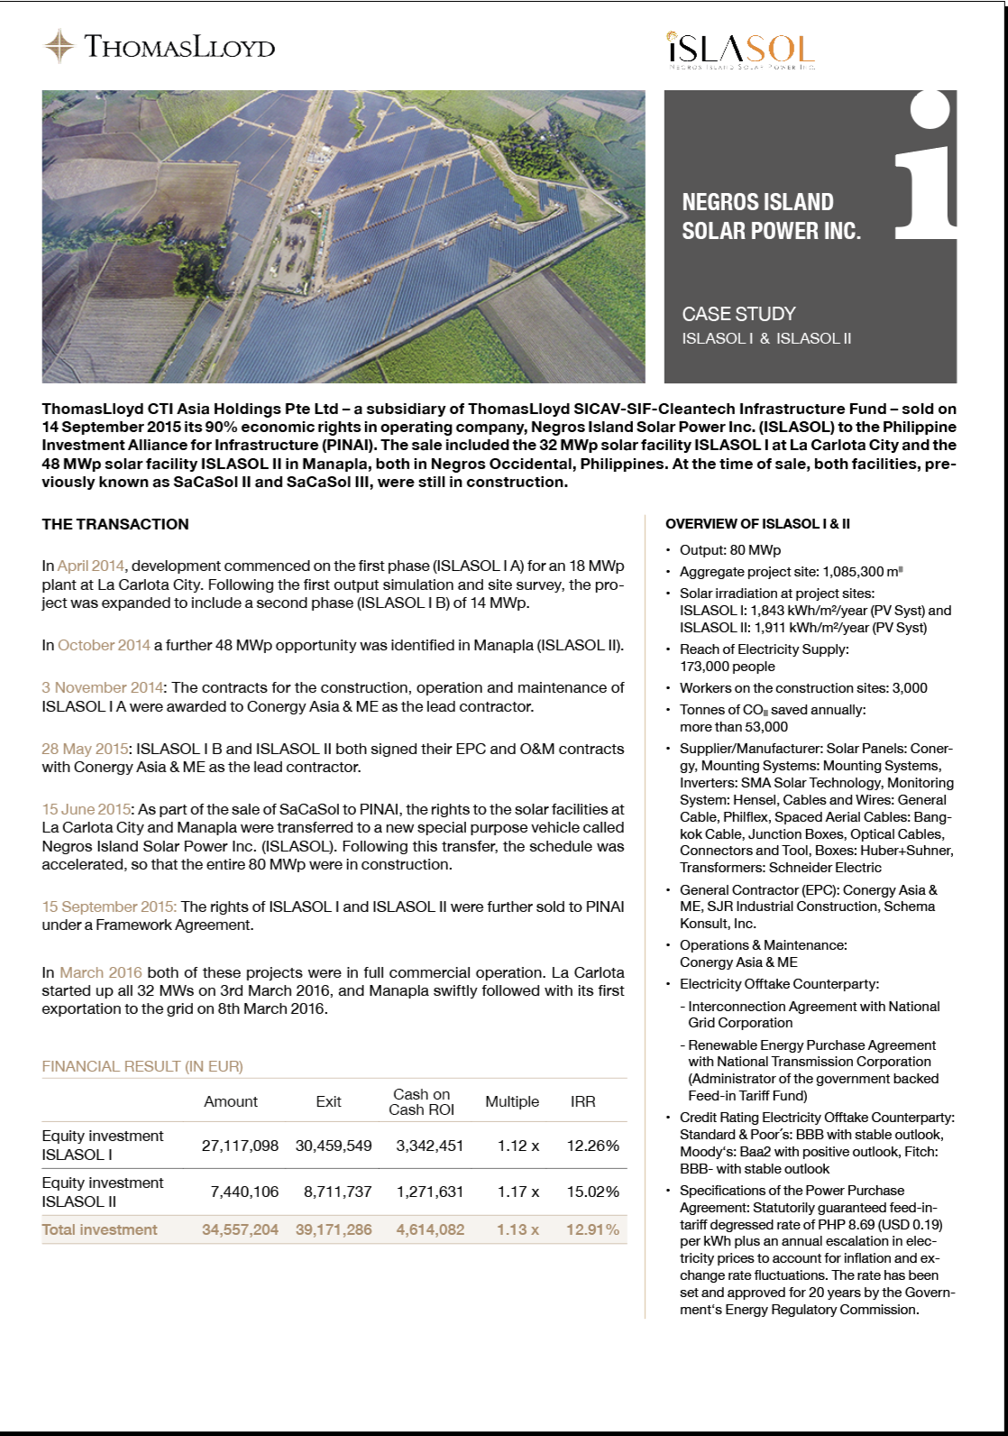
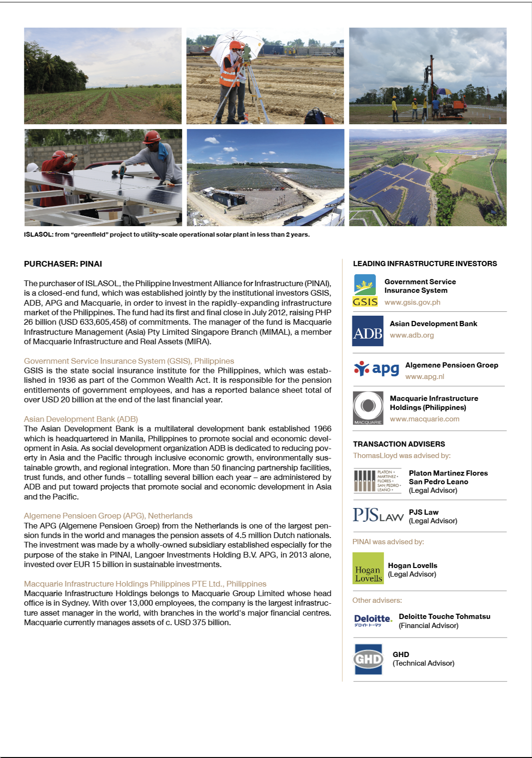
Case Study Islasol
Notes:
Collectively, we have worked with a vast array of key market participants in the region, our network is the equal of any in the sector

Slide 27
Legal Structure
Notes:
Collectively, we have worked with a vast array of key market participants in the region, our network is the equal of any in the sector

Slide 28
Important notices.
This presentation is being provided to you solely for your information. This presentation is not for publication or distribution, directly or indirectly, in whole or in part, into or within Canada, Australia, Japan or the Republic of South Africa, the United States or any other jurisdiction where to do so might constitute a violation of the relevant laws or regulations of such jurisdiction. Any failure to comply with these restrictions may constitute a violation of applicable securities laws.
This presentation is strictly private and confidential and has been prepared by ThomasLloyd Climate Solutions B.V. (the “Company”). The information contained in this announcement is for background purposes only and does not purport to be full or complete. This presentation is based on management beliefs and is subject to updating, revision and amendment. This presentation is an advertisement and is not a prospectus for the purposes of the Prospectus Regulation Rules of the AFM and has not been approved by the AFM. Investors should not subscribe for any of the Company’s shares (the “Shares”) on the basis of this presentation. You should conduct your own independent analysis of all relevant data provided in this presentation and any prospectus to be published by the Company and you are advised to seek expert advice before making any investment decision. In this notice, “affiliates” includes, in relation to the Company, their respective holding companies, companies under control of such holding companies, and subsidiaries and their respective directors, officers, employees, sub-contractors, agents and representatives.
The information and opinions contained in this presentation are provided as at the date of this presentation (unless otherwise marked) and are subject to verification, change, material updating and revision and no reliance may be placed for any purposes whatsoever on the information contained in this presentation or on its accuracy, completeness or fairness. No representation or warranty, express or implied, is given by or on behalf of the Company, or any of its respective affiliates or partners with respect to the accuracy or completeness of the information contained in this presentation or on which this presentation is based or any other information or representations supplied or made in connection with the presentation or as to the reasonableness of any projections which this presentation contains. The aforementioned persons disclaim any and all responsibility and liability whatsoever, whether arising in tort, contract or otherwise, for any errors, omissions or inaccuracies in such information or opinions or for any loss, cost or damage suffered or incurred howsoever arising, directly or indirectly, from any use of this presentation or its contents or otherwise in connection with this presentation.
Persons reading this document must make all trading and investment decisions in reliance on their own judgement. No statement in this presentation is intended to be nor may be construed as a profit forecast. Certain of the industry and market data contained in this document comes from third party sources. Third party industry publications, studies and surveys generally state that the data contained therein have been obtained from sources believed to be reliable, but that there is no guarantee of the accuracy or completeness of such data. This presentation is not intended to provide, and should not be construed as or relied upon for legal, tax, financial, business, regulatory or investment advice, nor does it contain a recommendation regarding the purchase of any Shares.
The merits or suitability of any securities must be independently determined by the recipient on the basis of its own investigation and evaluation of the Company. Any such determination should involve, among other things, an assessment of the legal, tax, accounting, regulatory, financial, credit and other related aspects of the securities. Potential investors are advised to seek expert advice before making any investment decision. Nothing in this presentation is, or should be relied on as a promise or representation as to the future. In furnishing this presentation, neither the Company nor any of its respective affiliates undertakes to provide the recipient with access to any additional information or to update this presentation or to correct any inaccuracies therein which may become apparent.
The information contained in this presentation is confidential and may not be reproduced, redistributed, published or passed on, directly or indirectly, to any other person or published, in whole or in part, for any purpose. In addition, certain information contained in this presentation has been obtained from published and non-published sources prepared by other parties, which in certain cases have not been updated to the date hereof. While such information is believed to be reliable for the purpose used in this presentation, neither the Company nor its respective affiliates assumes any responsibility for the accuracy, fairness or completeness of such information and such information has not been independently verified by the Company or its respective affiliates.
This presentation is only addressed to and directed at: (a) outside the United States to persons that are not U.S. Persons (as defined in Regulation S (“Regulation S”) (“US Persons”) under the US Securities Act of 1933, as amended (the “Securities Act”)) in reliance upon Regulation S; or (b) in the United States or to US Persons, only to persons that are both “qualified purchasers” (“QPs”) as defined in the US Investment Company Act of 1940, as amended (the “Investment Company Act”) and “qualified institutional buyers” (“Qualified Institutional Buyers”) as defined in Rule 144A under the Securities Act. No person should act or rely on this presentation and persons distributing this presentation must satisfy themselves that it is lawful to do so. Any issuance of Shares by the Company is directed at Qualified Investors only. The Shares have not been and will not be registered under the Securities Act. Outside the United States, the Shares may be sold to persons who are not US Persons pursuant to Regulation S under the Securities Act. Any sale of shares in the United States or to US Persons may only be made to persons reasonably believed to be QIBs that are also QPs.

Slide 29
Important notices.
There will be no public offering of the Shares in the United States. This presentation is not an offer of securities for sale in the United States. This presentation does not constitute or form part of any offer for sale or subscription or any solicitation of any offer to buy or subscribe for any securities and neither this document nor any part of it forms the basis of or may be relied on in connection with or act as an inducement to enter into any contract or commitment whatsoever. The distribution of this presentation and the offering and sale of participation rights or other securities in certain jurisdictions may be restricted by law and therefore persons into whose possession this presentation comes should inform themselves and observe any applicable restrictions.
This presentation is not for transmission to, publication or distribution or release in Canada, Australia, Japan or the Republic of South Africa, or to any other country where such distribution may lead to a breach of any law or regulatory requirement, or to any national, resident or citizen of such jurisdiction. Certain statements in this presentation constitute forward-looking statements. All statements that address expectations or projections about the future, including statements about operating performance, market position, industry trends, general economic conditions, expected expenditures and financial results, are forward-looking statements. Some of the forward-looking statements may be identified by words like “expects”, “anticipates”, “targets”, “continues”, “estimates”, “plans”, “intends”, “projects”, “indicates”, “believes”, “may”, “will”, “should”, “would”, “could”, “outlook”, “forecast”, “plan”, “goal” and similar expressions (or negatives and variations thereof).
Any statements contained herein that are not statements of historical fact are forward-looking statements. These statements are not guarantees of future performance and involve a number of risks, uncer- tainties and assumptions. Accordingly, actual results or the performance of the Company or their respective subsidiaries or affiliates may differ significantly, positively or negatively, from forward-looking statements made herein. Due to various risks and uncertainties, actual events or results or actual performance may differ materially from those reflected or contemplated in such forward-looking statements. As a result, you should not rely on such forward-looking statements in making any investment decision.
No representation or warranty is made as to the achievement or reasonableness of, and no reliance should be placed on, such forward looking statements. Nothing in this presentation should be relied upon as a promise or representation as to the future. Certain figures contained in this presentation have been subject to rounding adjustments. Accordingly, in certain instances, the sum or percentage change of the numbers contained in this presentation may not conform exactly to the total figure given.
By accepting or reading a copy of this presentation, you agree to be bound by the foregoing limitations and conditions and, in particular, will be taken to have represented, warranted and undertaken that:
(i) you have read and agree to comply with the contents of this notice including, without limitation, the obligation to keep this presentation and its contents confidential, (ii) you will not at any time have any discussion, correspondence or contact concerning the information in this presentation or any related presentation with any of the directors or employees of the Company or their respective subsidiaries or affiliates nor with any of their respective suppliers, customers, sub-contractors or any governmental or regulatory body without the prior written consent of the Company or, (iii) you have not received this presentation on behalf of persons in the United States (other than QIBs who are also QPs) or persons in the European Economic Area (other than Qualified Investors in eligible EEA Member States), for whom you have authority to make decisions on a wholly discretionary basis, and that you understand the legal and regulatory sanctions attached to the misuse, disclosure or improper circulation of this presentation.

Slide 30
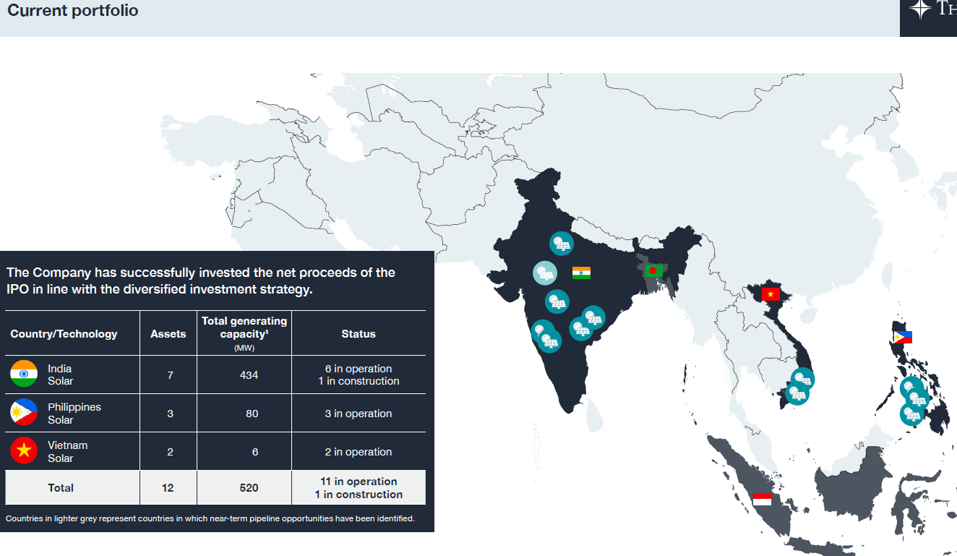
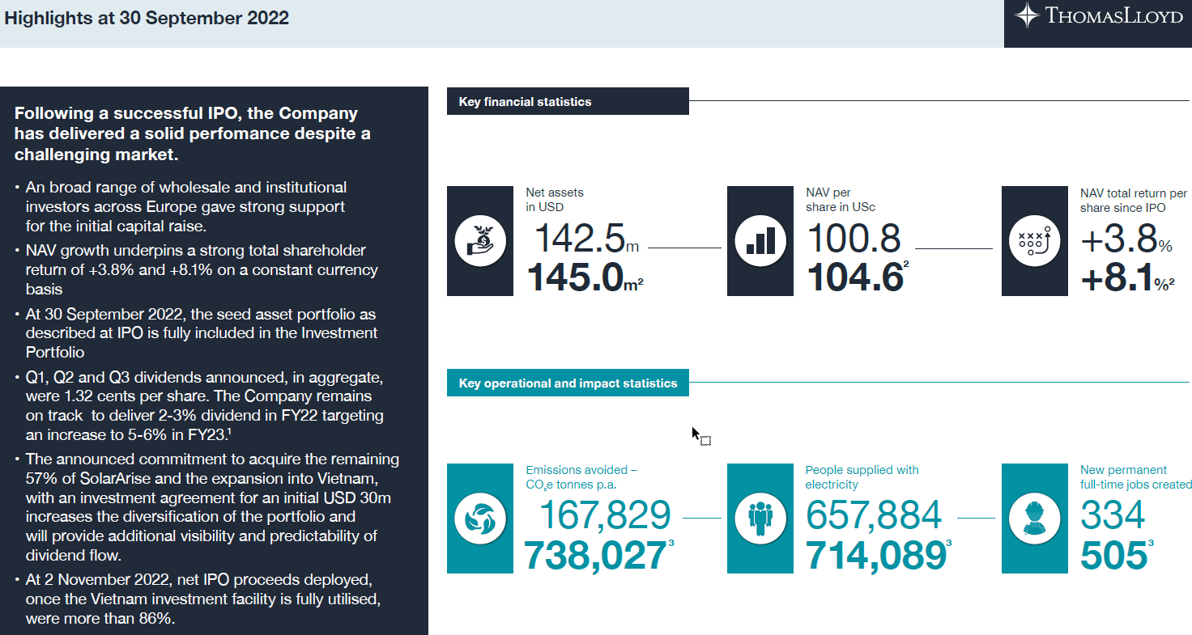
Investment Thesis.
Beyond saving the planet
- Current Financial Position:
- Run Rate Revenues and EBIDTA – Forecast 2023-2028
- Current external debt level – XX
- Debt to Equity / Debt to EBIDTA (
- Current Cap table – key shareholding details – Prospectus (Management)
- XX Selfsufficient ….
- XX …….
Target financial position in 5 years
Run Rate Revenues and EBIDTA – XX
Leverage
Resources needed to achieve above position
Equity capital –
Debt –
Team –
Notes:
The key leaders in the group demonstrate our diversity of experience across technologies geographies and business models.
We aim to attract and retain a balance of experience like this in as many segments of the business as we can.
The depth and breadth experience of our team in clean energy and technology is, we firmly believe, the equal of any company operating in this space.
Complimented by strong NED’s that bring additional balance to the leadership team.

Slide 31
A diverse pipeline for growth.
630m EUR
Clean power, clean water, clean waste. A single platform.
Notes:
Our diverse pipeline allows us to work with customers across the entire value chain, easier for them and better for our margins.
TCS combines vast global experience to a nimble, European managed firm.
The opportunity is unrivalled. Unlike EU/NA clean energy, demand significantly exceeds supply in Asia.
The pipeline is markedly different from our peers. This is a great risk diversifier and can enhance earnings growth.
Where developed market opportunities are in a race to zero margins, we remain in a race to achieve a net-zero world, without compromising margins.

Slide 32
Pipeline breakup.

Slide 33
Target.
- Todays Valuation:
- Enterprise Value
- Equity Value
Target Valuation in 5 years
EV
Equity
XX% CAGR over todays valuation including capital raise required
Notes:
The key leaders in the group demonstrate our diversity of experience across technologies geographies and business models.
We aim to attract and retain a balance of experience like this in as many segments of the business as we can.
The depth and breadth experience of our team in clean energy and technology is, we firmly believe, the equal of any company operating in this space.
Complimented by strong NED’s that bring additional balance to the leadership team.

Slide 34
Warum können wir günstiger liefern: Economies of scale, lower procurement costs, lower capital costs, efficiencies by harmonizing all solutions end to end
Conclusion.
Samples
…
Infra mayor … we have the people, the systems, market access > now capital….. To accelerate …. With aligned shareholders, TCS will deliver a corporate decarbonisation infrastructure major
Key statements: Connect, facilitate, enable, …….
We own as little as possible and as much as necessary to make things happen/ reach our target, we want control with as little CAPEX as possible.
22 year trackrecord
… we have the people, the systems, market access, … in place > now listing/capital….. To accelerate …. Become first EU listed, safe gateway / conventional model utility-scale RE solar and wind > race to zero, commoditzed
The challenge and the opportunity isn´t equally distributed. Superior margins and impact are found in energy growth markets and specialist sectors and industries/segments.
Notes:
We have experience, structure and ambition,
We have a strong asset base/balance sheet
We have a broad base of existing stakeholders
We are ready to grow significantly from that base.
We are different to most companies in this space.
This is not a claim to be better than everyone else, but a justified claim to be different enough that we can play a strong part in any portfolio

Slide 35
Financial highlights TCS AG.
There is significant opportunity to grow our market share in existing geographic markets and technology segments, this opportunity has longevity.
We aim to expand organically, by replicating existing successful assets through additional greenfield projects using our proven technology expertise, while scaling the associated financial and technical services to the same extent
The Group has a proven track record of developing, financing, constructing and operating in its existing geographic markets and technology segments
To support and balance our organic growth ambitions we will also continuously assess and pursue M&A opportunities at the local level
1. Drive market share in existing geographic markets and technology segments
17
Notes:
The Group's mission is to achieve significant and consistent revenue growth by offering a diversified end-to end climate change and energy transitions service globally.
Again, the opportunity set is beyond that of Western markets. We can do much more of the same, without compromising margins.
Our execution in the market allows us to pick the deals that provide both balance and return.

Slide 36
Four strategic pillars.
There is significant opportunity to grow our market share in existing geographic markets and technology segments, this opportunity has longevity.
We aim to expand organically, by replicating existing successful assets through additional greenfield projects using our proven technology expertise, while scaling the associated financial and technical services to the same extent
The Group has a proven track record of developing, financing, constructing and operating in its existing geographic markets and technology segments
To support and balance our organic growth ambitions we will also continuously assess and pursue M&A opportunities at the local level
1. Drive market share in existing geographic markets and technology segments
17
Notes:
The Group's mission is to achieve significant and consistent revenue growth by offering a diversified end-to end climate change and energy transitions service globally.
Again, the opportunity set is beyond that of Western markets. We can do much more of the same, without compromising margins.
Our execution in the market allows us to pick the deals that provide both balance and return.

Slide 37
Four strategic pillars.
We continue to assess new opportunities in countries that either have regulatory, macro or clean energy demand profiles comparable to our existing markets, which are under-developed and not yet commoditized
Selection of new markets will be based on scalability, strong structural and/or macro-economic tailwinds, and where we have a competitive advantage
Risk management and market scale means that our efforts focus on researching applied and proven technologies which are transferable across markets
Assessing their practical application, driving profitability, operational excellence and accelerate the Group´s impact-led strategic aims. By integrating proven technologies in new ways, we can improve margins without additional risks
2. Expansion into new markets, harnessing existing technology, particularly base-load, and to drive efficiencies.
17
Notes:
The previous slide was to do more of the same, this is about diversifying revenue streams from proven but not yet commoditised technology.
By being able to operate in these gaps in the market, we can generate returns in excess of the market average.
Our platform approach allows for multiple complimentary projects that enhance the risk/return balance.

Slide 38
Four strategic pillars.
The Group benefits from economies of scale across the platform, lowering procurement and administration costs and enhancing vertical and horizontal integration by adding further complimentary businesses to the platform
This approach allows us to improve margins, lower execution and operational risks and for each country platform to play a larger part
The Group focuses on maximising cash flow to allow for recycling into new greenfield developments
In-country M&A opportunities can be more efficiently executed by leveraging transferable skills sets and Intellectual property
3. Efficient operating model and prudent capital allocation to drive margin expansion and optimize shareholder returns.
17
Notes:
By formally consolidating the group into one operating entity;
Our ability execute efficiently is further refined
We can share IP more readily
We can enhance returns and drive corporate and balance sheet efficiencies.

Slide 39
Four strategic pillars.
Investing in sustainable energy in Asia creates on average >4x the impact compared to Europe or North America. Asia's high 'carbon cost' of GDP highlights an urgent and significant need
Our flexible approach combines well with the size of the market opportunity, allowing us to chose high margin projects and avoiding the commoditized approach necessitated by many of the larger companies in the market
Our impact and return profile differentiates us from other investment opportunities in the sector
Harnessing diverse technology and applications allows the group to drive efficiencies, grow revenue and therefore shareholder returns and impact metrics.
4. Maximizing global impact and returns
17
Notes:
Impact in Asia is higher than in the developed/Western world and yet, makes a global difference.
The focus by many EU based competitors is on home markets, that have often had to rely on subsidies.
Our markets need no subsidies, they need clean energy and technology.
Demand will continue to outstrip supply unless and until more firms like TCS operate in this space. This is a multi-year opportunity.

Slide 40
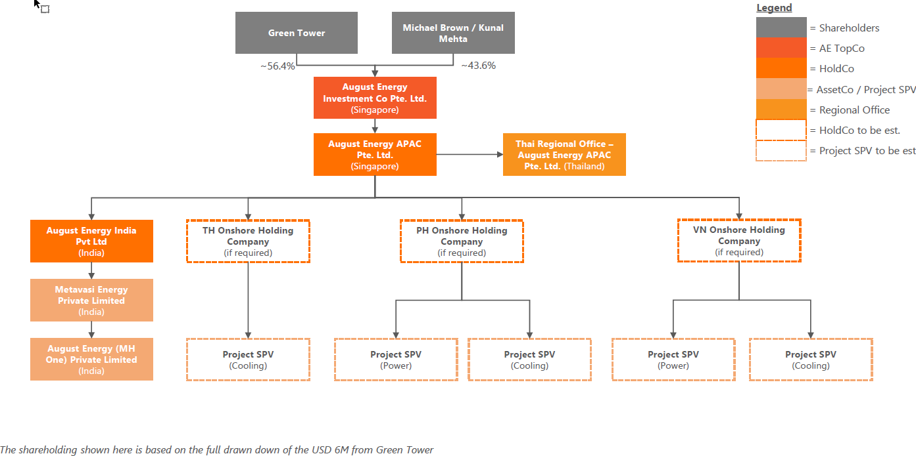
Appendices – Envisaged corporate structure
Our Group Structure.
ThomasLloyd Climate Solutions N.V.
100%
100%
ThomasLloyd Climate Solutions Ltd
United Kingdom
ThomasLloyd CTI Asia Holdings PTE Ltd
Singapore
ThomasLloyd Water Impact Development […] PTE Ltd
……
ThomasLloyd Climate Solutions AG
Switzerland
San Carlos BioPower Inc
Philippines
ThomasLloyd Climate Solutions GmbH
Germany
South Negros BioPower Inc
Philippines
ThomasLloyd Climate Solutions LLC
USA
North Negros BioPower Inc
Philippines
ThomasLloyd Climate Solutions Pte Ltd
Singapore
ThomasLloyd Energy Impact Development India Pte Ltd
India
Houses Philippines BioPower and BioFuel business
Assets
Climate Solutions
Business Segment
Matrix
Shows envisaged group structure after completion of reorganization
TBD: US HoldCo, CTI Phil, BP TopCo
Notes:
We have experience, structure and ambition,
We have a strong asset base/balance sheet
We have a broad base of existing stakeholders
We are ready to grow significantly from that base.
We are different to most companies in this space.
This is not a claim to be better than everyone else, but a justified claim to be different enough that we can play a strong part in any portfolio

Slide 41
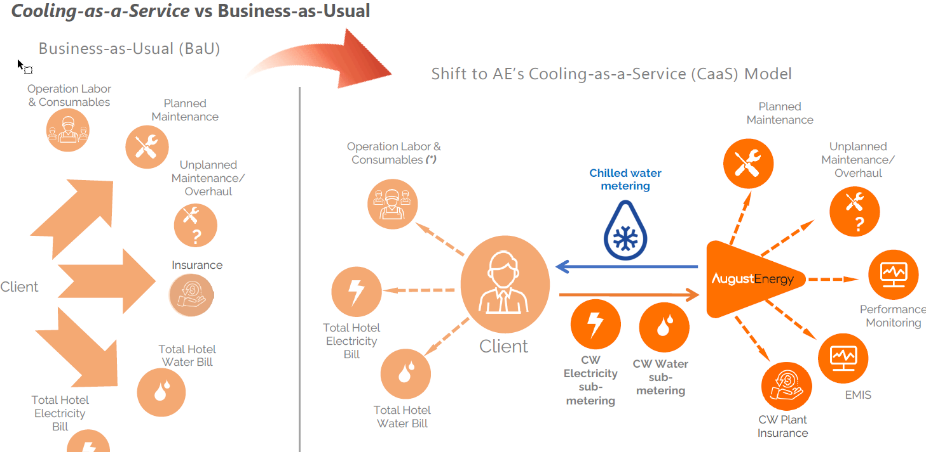
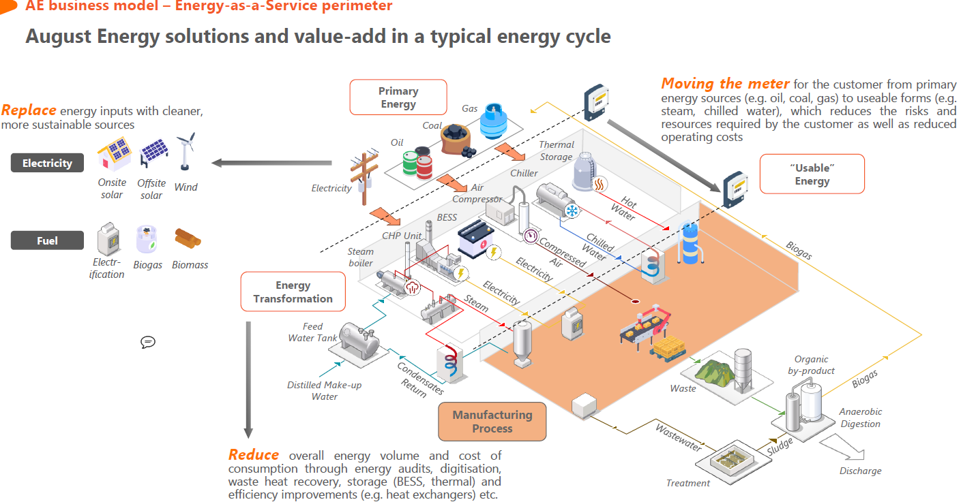
Business Model.
Samples
…
Multi-Utility and environmental services onsite/offsite
Notes:
We have experience, structure and ambition,
We have a strong asset base/balance sheet
We have a broad base of existing stakeholders
We are ready to grow significantly from that base.
We are different to most companies in this space.
This is not a claim to be better than everyone else, but a justified claim to be different enough that we can play a strong part in any portfolio

Slide 42
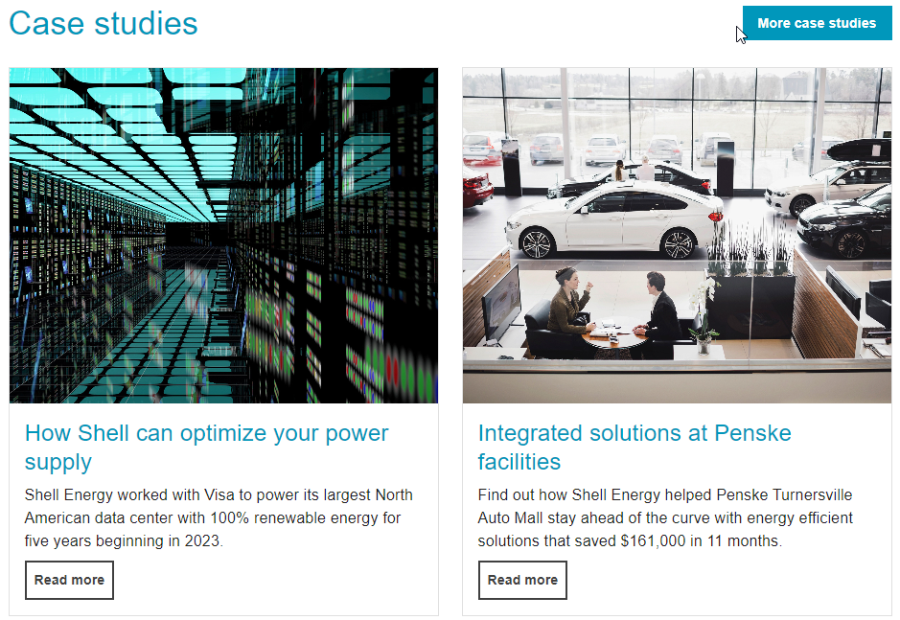
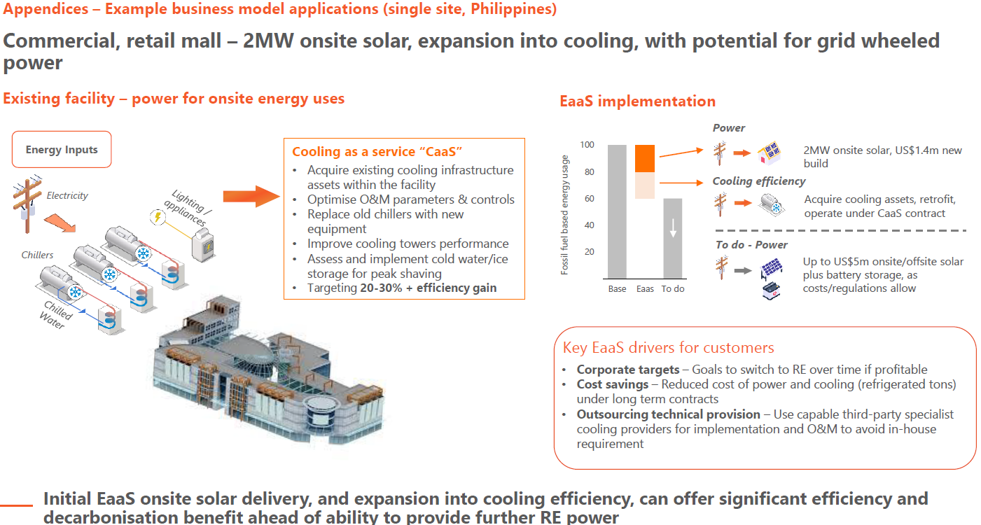
Appendix – Sample Client.
Shows envisaged group structure after completion of reorganization
TBD: US HoldCo, CTI Phil, BP TopCo
Notes:
We have experience, structure and ambition,
We have a strong asset base/balance sheet
We have a broad base of existing stakeholders
We are ready to grow significantly from that base.
We are different to most companies in this space.
This is not a claim to be better than everyone else, but a justified claim to be different enough that we can play a strong part in any portfolio

Slide 43
Our Target Markets Comparative.
Particulars | India | Philippines | Indonesia | Vietnam | US | EU
Demographics
Area (million sq km) | 3.3 | 0.3 | 1.9 | 0.33 | 9.8 | 4.2
Population (million) | 1409 | 118 | 282 | 106 | 342 | 452
population growth rate | 0.7% | 1.6% | 0.7% | 0.9% | 0.7% | 0.1%
Median age | 30 | 26 | 32 | 33 | 39 | 44
15-64 yrs age | 69% | 64% | 68% | 69% | 63% | 64%
>65 yrs | 7% | 6% | 8% | 8% | 19% | 22%
Urban population | 36% | 48% | 59% | 40% | 83% | 76%
Economy
GDP ($ billion) | 3,550 | 437 | 1,371 | 430 | 27,361 | 18,349
Real GDP Growth Rate | 7.6% | 5.6% | 5.1% | 5.1% | 2.5% | 0.5%
GDP per capita($) | 2,519 | 3,696 | 4,869 | 4,063 | 80,012 | 40,613
Credit Rating (S&P) | BBB- | BBB | BBB | BB | AA+ | AA
Inflation | 5.7% | 6.0% | 3.7% | 3.3% | 4.1% | 6.3%
Industrial production growth rate | 9.0% | 3.6% | 5.0% | 3.7% | 3.3% | -1.0%
Labour Force (million) | 594 | 49 | 141 | 56 | 171 | 222
Electricity / Energy
Electricity installed (GW) | 487 | 28 | 70 | 85 | 1,201 | 1,050
Electricity consumption (billion kWh / terawatt-hr) | 1,463 | 103 | 312 | 252 | 4,128 | 2,700
Electricity per capita consumption (kWh / units) | 1,038 | 869 | 1,110 | 2,379 | 12,072 | 5,976
Electricty source: Fossil Fuel | 76% | 78% | 80% | 57% | 60% | 39%
Electricity source: solar/wind | 10% | 3% | 0% | 13% | 15% | 24%
Electricity source: hydro | 10% | 8% | 8% | 30% | 6% | 11%
Electricity source: biomass/waste | 2% | 1% | 7% | 1% | 2% | 4%
Electricty source: nuclear / others (geothermal etc) | 3% | 10% | 5% | 0% | 18% | 22%
TCS' Proposed Investment | 124 | 303 | 67 | 31
Demographics:
Urbanisation in Asian markets (~40%) has still a long way to catch up with the west ~80%. More the urbanisation, higher the energy consumption.
Population growth in absolute terms is 5.5x of US+EU
Economy:
GDP per capita: 1/15th of the west on an average. As it grows, with higher GDP growth rate in the region, energy consumption grows (at 1.1x-1.2x of GDP growth rates).
Infra spending in the west is mostly replacement driven, owing to lower population and growth. Asian markets needs to develop incremental infra to catch up with demand
Energy:
Per capita electricity consumption is 1/8th of the west on weighted average
Generation from solar/wind/hydro/bio is 1/4th of the west on an average.
Immense scope of growth in Clean Energy consumption in the Asian Markets
Source: https://www.cia.gov/the-world-factbook/countries/
Notes:
Comments to be added shortly on these new slides

Slide 44
Opportunities in our Key Asian Markets.
Philippines
India
Notes:
Comments to be added shortly on these new slides

Slide 45
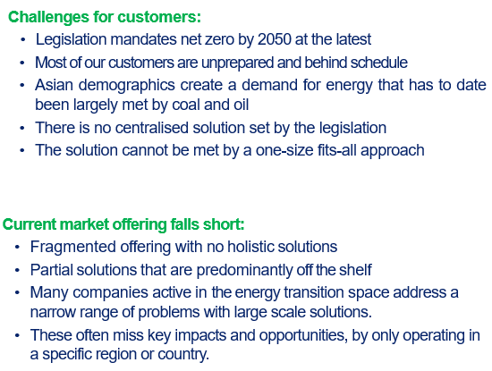
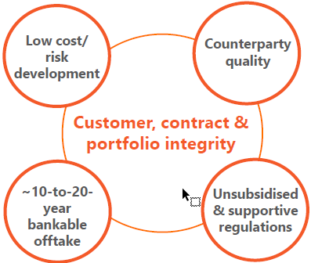
Organic expansion /accelerated organic expansion / M&A
Pureplay global energy transition platform, with focus on corporate and industrial,[….] decarbonization, [also supporting utilities, ….] benefits from no reliance on subsidization as well as limited government intervention / sharp, agile, adaptle model … / TCS is more than the sum of its parts
Expansion potential with single customer
Securing a first project with a quality customer provides route to expansion across multiple sites and solutions with shorter lead times and lower competitive pressure
In each market, local partners and multi-site commercial customers will provide significant expansion routes for the company’s differentiated cooling offering
… We´re a utility or provide distributed energy
From full outsourced solutions …. Energy/Water/Cooling/Heating….-as-a-Service (EaaS) to modular solutions ..
Competitive landscape, no one has brought it together yet. Old/long established can´t change, new has not the people, capital, systems
client centric model
Creating an institutional quality corporate decarbonisation leader by developing and investing in cleaner energy solutions today, profitably, efficiently and at scale
More impact and higher returns
Notes:
We have experience, structure and ambition,
We have a strong asset base/balance sheet
We have a broad base of existing stakeholders
We are ready to grow significantly from that base.
We are different to most companies in this space.
This is not a claim to be better than everyone else, but a justified claim to be different enough that we can play a strong part in any portfolio

Slide 46
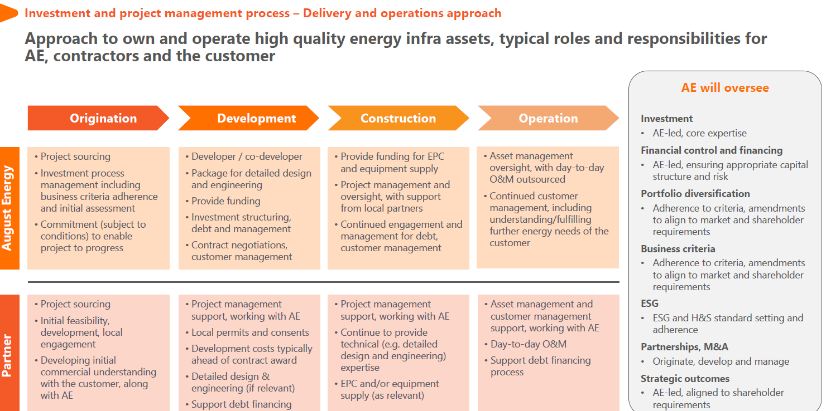
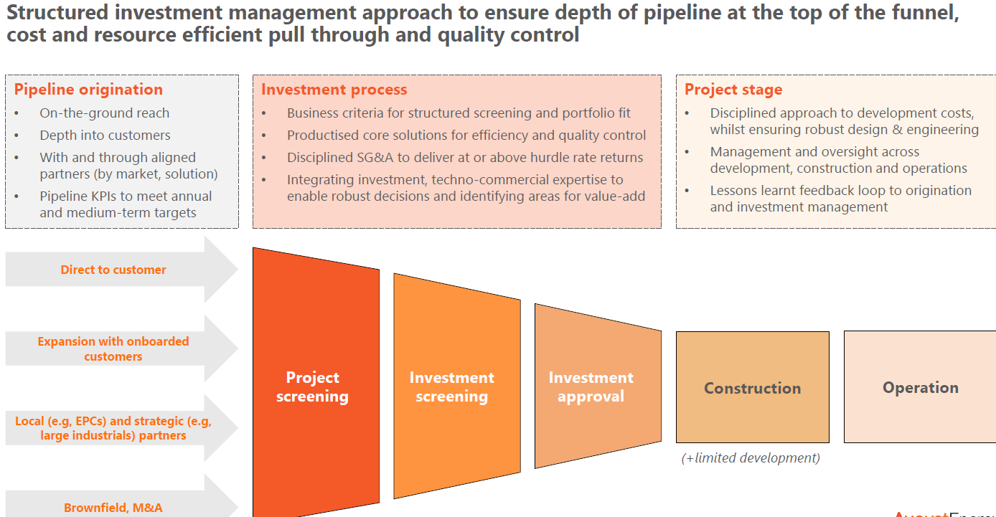
Growth and Expansion.
KD/Lösung in der Mitte > zeigen was schon da und was noch kommt
Solution offerings expands by services and market availability
Focus on pivotal and high margin ….
Samples / Core and ancillary / Partner Model
…
Put SMEs on TCS global central platform to utilize cost synergies across back/mid offices (better quality for lower costs)
- Acquisition of innovative SME tech leaders with commercial proven tech and support global role out (add a new solution to the platform and offer to all existing clients across the platform (Cross selling))
Aggregation of local SME players (add-on acquisitions) to add additional clients and market access
Finance organic growth, new infra assets
Notes:
We have experience, structure and ambition,
We have a strong asset base/balance sheet
We have a broad base of existing stakeholders
We are ready to grow significantly from that base.
We are different to most companies in this space.
This is not a claim to be better than everyone else, but a justified claim to be different enough that we can play a strong part in any portfolio

